Slide 1

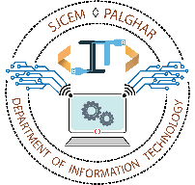
EXPENSE TRACKER
Aldel Education Trust’s
St. John College of Engineering and Management, Palghar
NAAC Accredited with Grade A (2017-2022)
Department of Information Technology
Abhijeet Singh [EU1194049]
Yash Patil [EU1194050]
Sridhar Srinivasan [EU1194047]
Siddhi Shirke [EU1194048]
Ms. Shraddha More | Asst. Professor
May 24, 2021

Slide 2
Contents
Abstract
Introduction
  Introduction
  Motivation
  Objectives
  Scope
Literature Review
Problem Statement
Proposed System (Block diagram)
Design and Implementation (Flow Chart)
Results and Discussion
Conclusion

Slide 3
Abstract
This project has been developed to cater to the dire need for an application that facilitates easy analysis of our expenses. Once aware of our expenses, we can not only keep a check but also cut down on the unrequired expenses
This project is developed using Python at front end and MySQL at backend used for database connection
This application will allow users to track their expenses in terms of dashboard and pie-chart
Unique features like notes and FAQs have been introduced coupled with features like dashboard, add income/expense, delete income/expense, statistics and users to enrich the user's experience
The system is designed such that it is an interactive and content management system dealing with creation, insertion and deletion of data
Thus, above features of this project will help in providing a responsible lifestyle by ensuring a balance between income and expenses. It will also help in deciding future investments without worrying about savings
keywords: expenses, budget, efficiency, responsible

Slide 4
Introduction
There is a dire need for an application that facilitates easy analysis of our expenses.
Once aware of our expenses, we can not only keep a check but also cut down the unrequired expenses, and this will help in providing a responsible lifestyle.
An application which is simple and user-friendly at the same time robust and efficient is the need of hour
The project aims to develop an Expense Tracker that helps its users to keep track of their expenses and determine whether they are spending as per their set budget.

Slide 5
Motivation
We thought to develop an application that tracks Expenses amid dearth for better Expense Trackers and an unreliable pen and paper approach
This application will allow users to track their expenses in terms of dashboard and pie-chart
Thus, on successful completion and implementation of this project, its features will help overcome challenges posed by conventional Expense Trackers and pen-paper approach

Slide 6
Objectives
To overcome challenges posed by traditional pen and paper approach
To provide a better alternative to weaker existing applications
To provide a safer environment protected by a password
To provide a simple user interface
To create a foundation for further enhancement of Expense Trackers

Slide 7
Scope
The scope of this project is to provide easy hassle-free tracking of expenses. This application will help overcome challenges posed by traditional pen and paper approach as well as weak existing applications. Users can create their accounts which will be protected by password set by them. Menu will have 8 options viz.
1. Dashboard: shows information of 5 latest income/expense inputs
2. Add income/expense: to add an income/expense to account
3. Delete income/expense: to delete an income/expense from account
4. Statistics: provides statistics in the form of pie-chart
5. Notes: to create short notes on transactions performed
6. Users: to view various users
7. FAQs: consists some of the Frequently Asked Questions
8. Logout: to logout of your account

Slide 8
Literature Review
Sr. No. | Paper Title [Ref.] | Author names | Advantages | Disadvantages
[1] | Daily Expense Tracker: An Android Based Mobile Application | Md. Abdul Karim, Taslima Yesmin Orin, Tasnim Ahmed, Ahmed Al Marouf | This application has an attractive user interface | This application does not allot a username
[2] | Online Income and Expense Tracker | S. Chandini, T. Poojitha, D. Ranjith, V. J. Mohammed Akram, M. S. Vani, V. Rajyalakshmi | This application displays statistics in the form of pie-charts | This application does not have an option of notes

Slide 9
Problem Statement
Once aware of our expenses, we can not only keep a check but also cut down the unrequired expenses
Tracking expenses using pen and paper approach is tedious. Calculation mistakes, missing out on entries and incorrect data entry are some of the pitfalls
Also pen and paper are difficult to carry everywhere. Expense trackers have potential to provide statistics such as pie-chart which are difficult to create in pen and paper approach
Hence there is a dire need for an expense tracker that helps to analyze our income and expense
Existing expense trackers fail to provide all features under single application

Slide 10
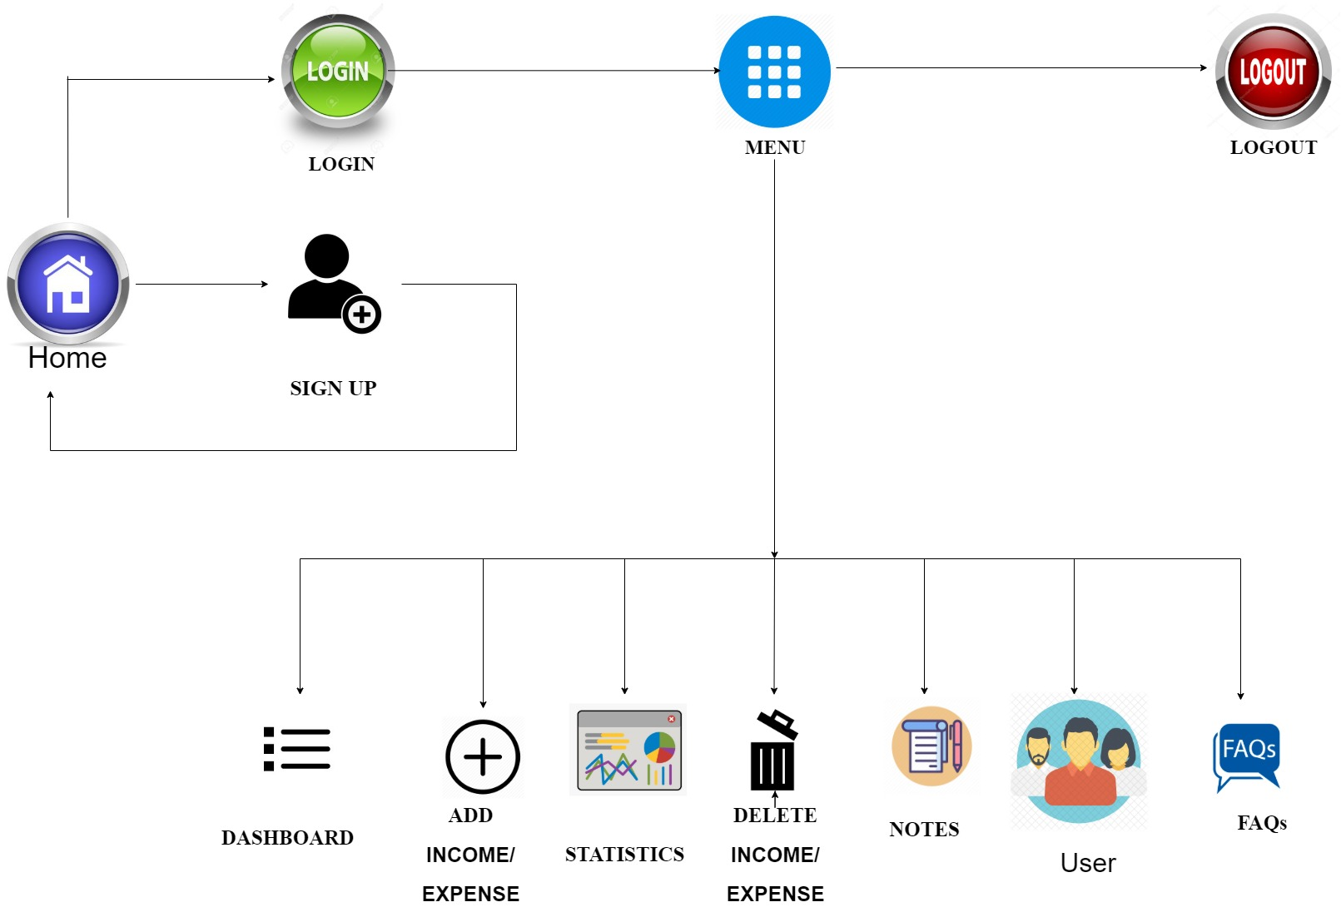
Proposed System

Slide 11
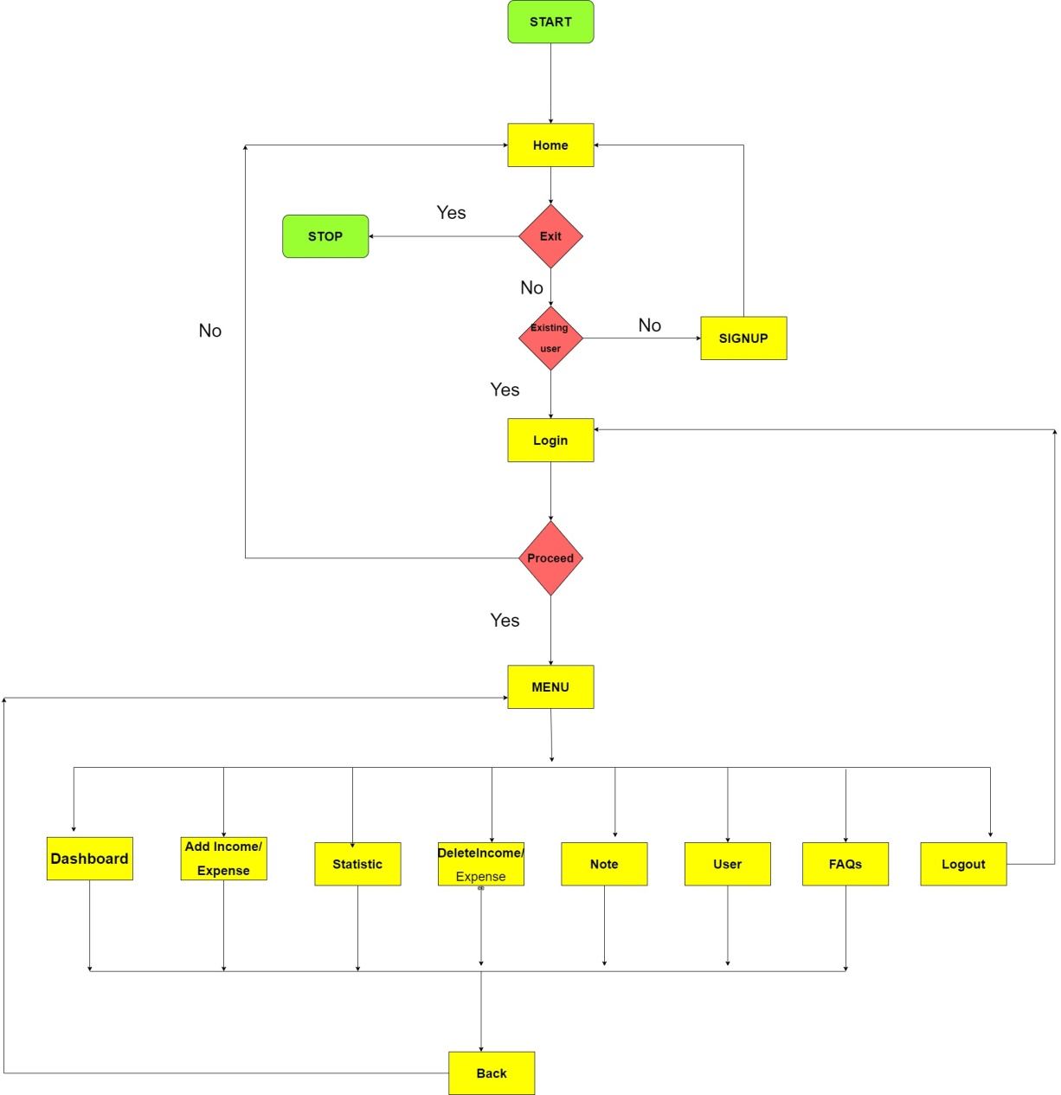
Design & Implementation

Slide 12
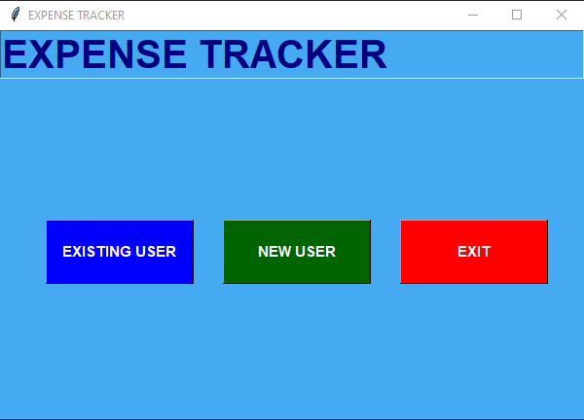
Results and Discussion
HOME

Slide 13
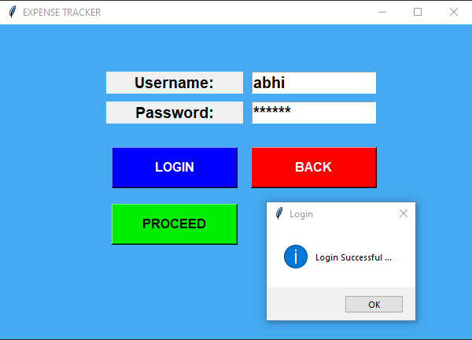
Results and Discussion
LOGIN

Slide 14
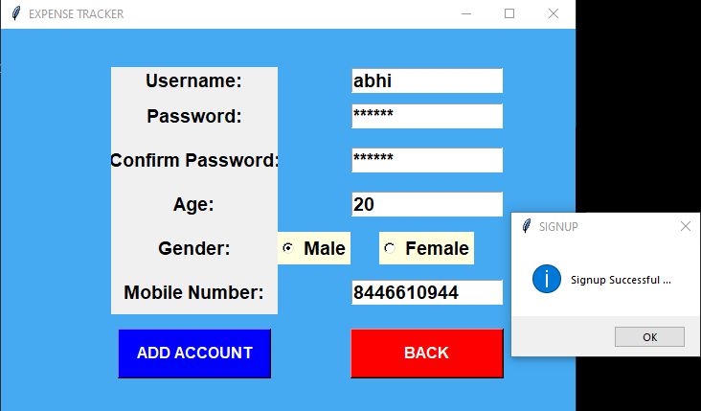
Results and Discussion
SIGNUP

Slide 15
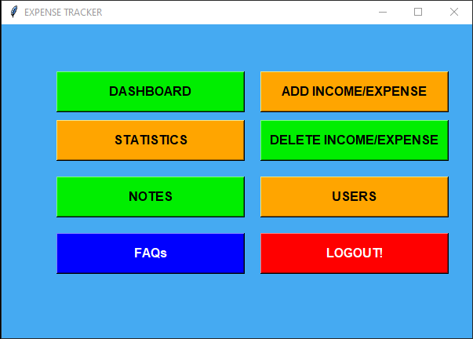
Results and Discussion
MENU

Slide 16
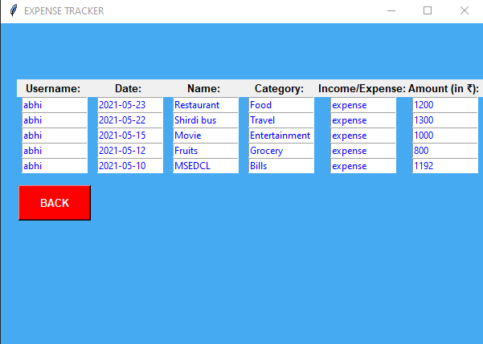
Results and Discussion
DASHBOARD

Slide 17
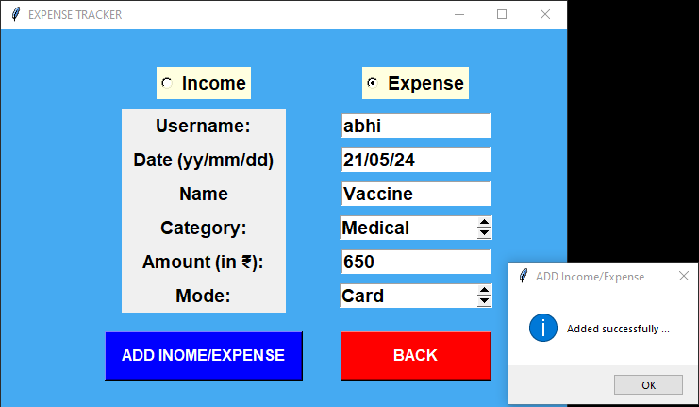
Results and Discussion
ADD INCOME/EXPENSE

Slide 18
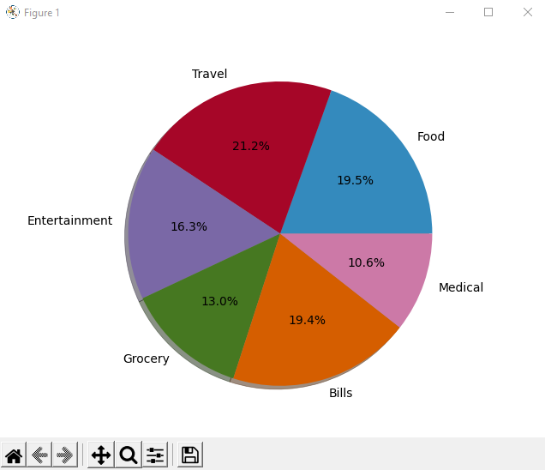
Results and Discussion
STATISTICS

Slide 19
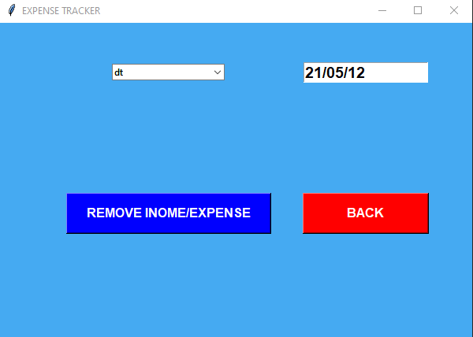
Results and Discussion
DELETE INCOME/EXPENSE

Slide 20
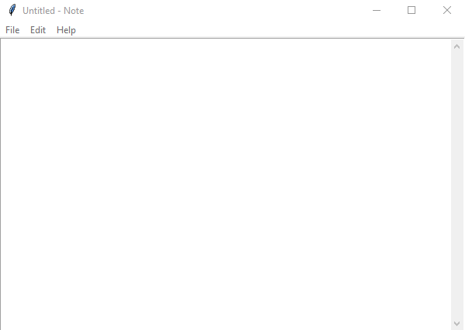
Results and Discussion
NOTES

Slide 21
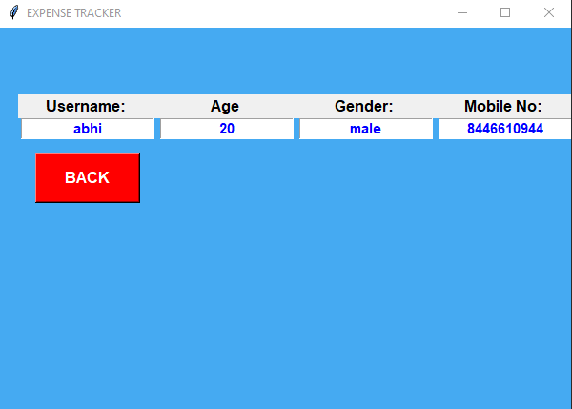
Results and Discussion
USERS

Slide 22
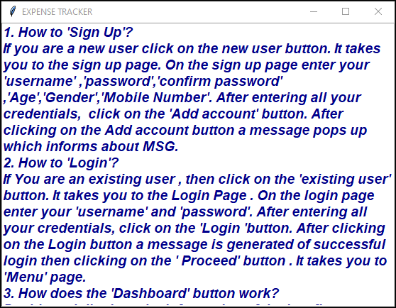
Results and Discussion
FAQs

Slide 23
Conclusion
Users will experience a smooth and stable application with new and efficient features that will enrich interaction between user and the application. The system is designed to be more user friendly without compromising on its features. Thus, tracking expenses has become much easier with this application.

Slide 24
Thank You !!!

Slide 25
Q & A

